Slide 1

What is your data worth? Equitable Valuation of Data
Amirata Ghorbani and James Y. Zou - Department Electrical Engineering, Stanford University, CA, USA
28 Feb 2020
Presenter: Sanchit Sinha
https://qdata.github.io/deep2Read/

Slide 2
Motivation
Data is important: in current state of the art classification models involving machine learning
Not all data created equal: some data points are more useful in training the classifier - they have higher discriminative value
How to quantify the quality of data: the paper explores this fundamental question regarding how to ascribe scores to data points wrt the usefulness in model training
Recognizing data as property: laws are being created to start identifying data as a property of a person, and hence, there is intrinsic value in the data.
Compensating people who provide data: people (especially in medical fields) volunteer to provide data. However, to motivate people to give data, there has to be some compensation which should depend on the quality of the data
Notes:
The motivation of this project

Slide 3
Background
Supervised Learning ingredients: training data (D), learning algorithm(A), and performance metric (V)
Assigning value to data in the setting of supervised learning is not equal
to assigning a universal to it - all learning algorithms depend on data
Shapley value: In a cooperative game, there are n players D = {1,...,n} and a score function v : 2^n → R assigns a reward to each of 2^n subsets of players: v(S) is the reward if the players in subset S ⊆ D cooperate.
Shapely uniquely divides the reward for cooperation of all players V(D) such that each player would get an equitable share of the reward.

Slide 4
Related Work
Shapley, L. S. A value for n-person games. Contributions to Theory Games 2, 307–317 (1953)
Bounding the estimation error of sampling-based shapley value approximation. arXiv preprint arXiv:1306.4265 (2013)
Steinhardt, J., Koh, P. W. W. & Liang, P. S. Certified defenses for data poisoning attacks. In Advances in Neural Information Processing Systems

Slide 5
Claim / Target Task
Come up with a technique to assign scores to data points depending on how good their quality is (how well they help in training the model)
Build a better valuation method than “leave one out” - the most intuitive way of assigning a score to the data point
Viewing the supervised machine learning problem as a cooperative game: each source in the train data is a player, and the players work together through the learning algorithm A to achieve prediction score
Speed up the number of computations required in the Data Shapely equation
Applying to Domain Adaptation by concentrating on the good quality data
Notes:
Here, we make the claim of this project.

Slide 6
Why not LOO?
Suppose a scenario where the training set contains n copies of each sample and consider using a KNN (with k<=n-1) to predict something using this data.
If we remove any sample from the training set, the KNN’s performance would not change since there are still n-1 identical copies of the removed sample in the dataset.
In this case, the LOO would attribute 0 value to all data points.
Notes:
Here, we make the claim of this project.

Slide 7
Data Summary
Datasets used:
ImageNet
UK Biobank
MNIST
UPS
Spam vs Email
Skin Lesions
Notes:
In the rest of this presentation, I’m going to talk about following contents:

Slide 8
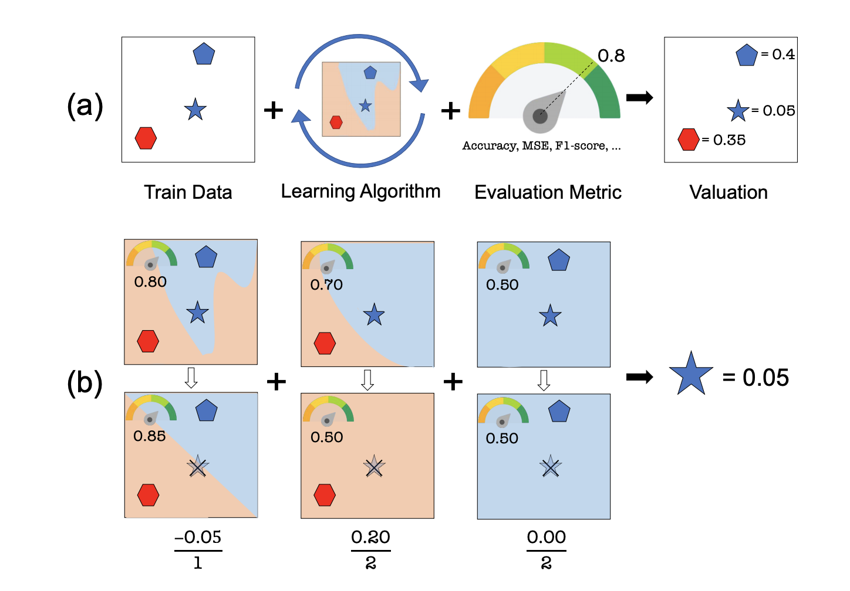
An Intuitive Figure Showing WHY Claim
Notes:
Here, we make the claim of this project.

Slide 9
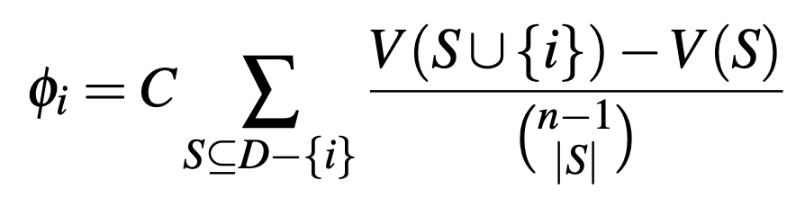
Proposed Solution - Properties
If (xi,yi) does not change the performance if it’s added to any subset of the train data sources, then it should be given zero value. For all S ⊆ D− {i}, V(S) = V(S∪ {i}), then φi = 0.
If for data i and j and any subset S ⊆ D− {i, j}, we have V(S∪ {i}) = V(S∪ { j}), then φi = φj.
When the overall performance score is the sum of separate performance scores, the overall value of a datum should be the sum of its value for each score: φi(V +W) = φi(V) +φi(W)
Notes:
Here is our proposed solution.

Slide 10
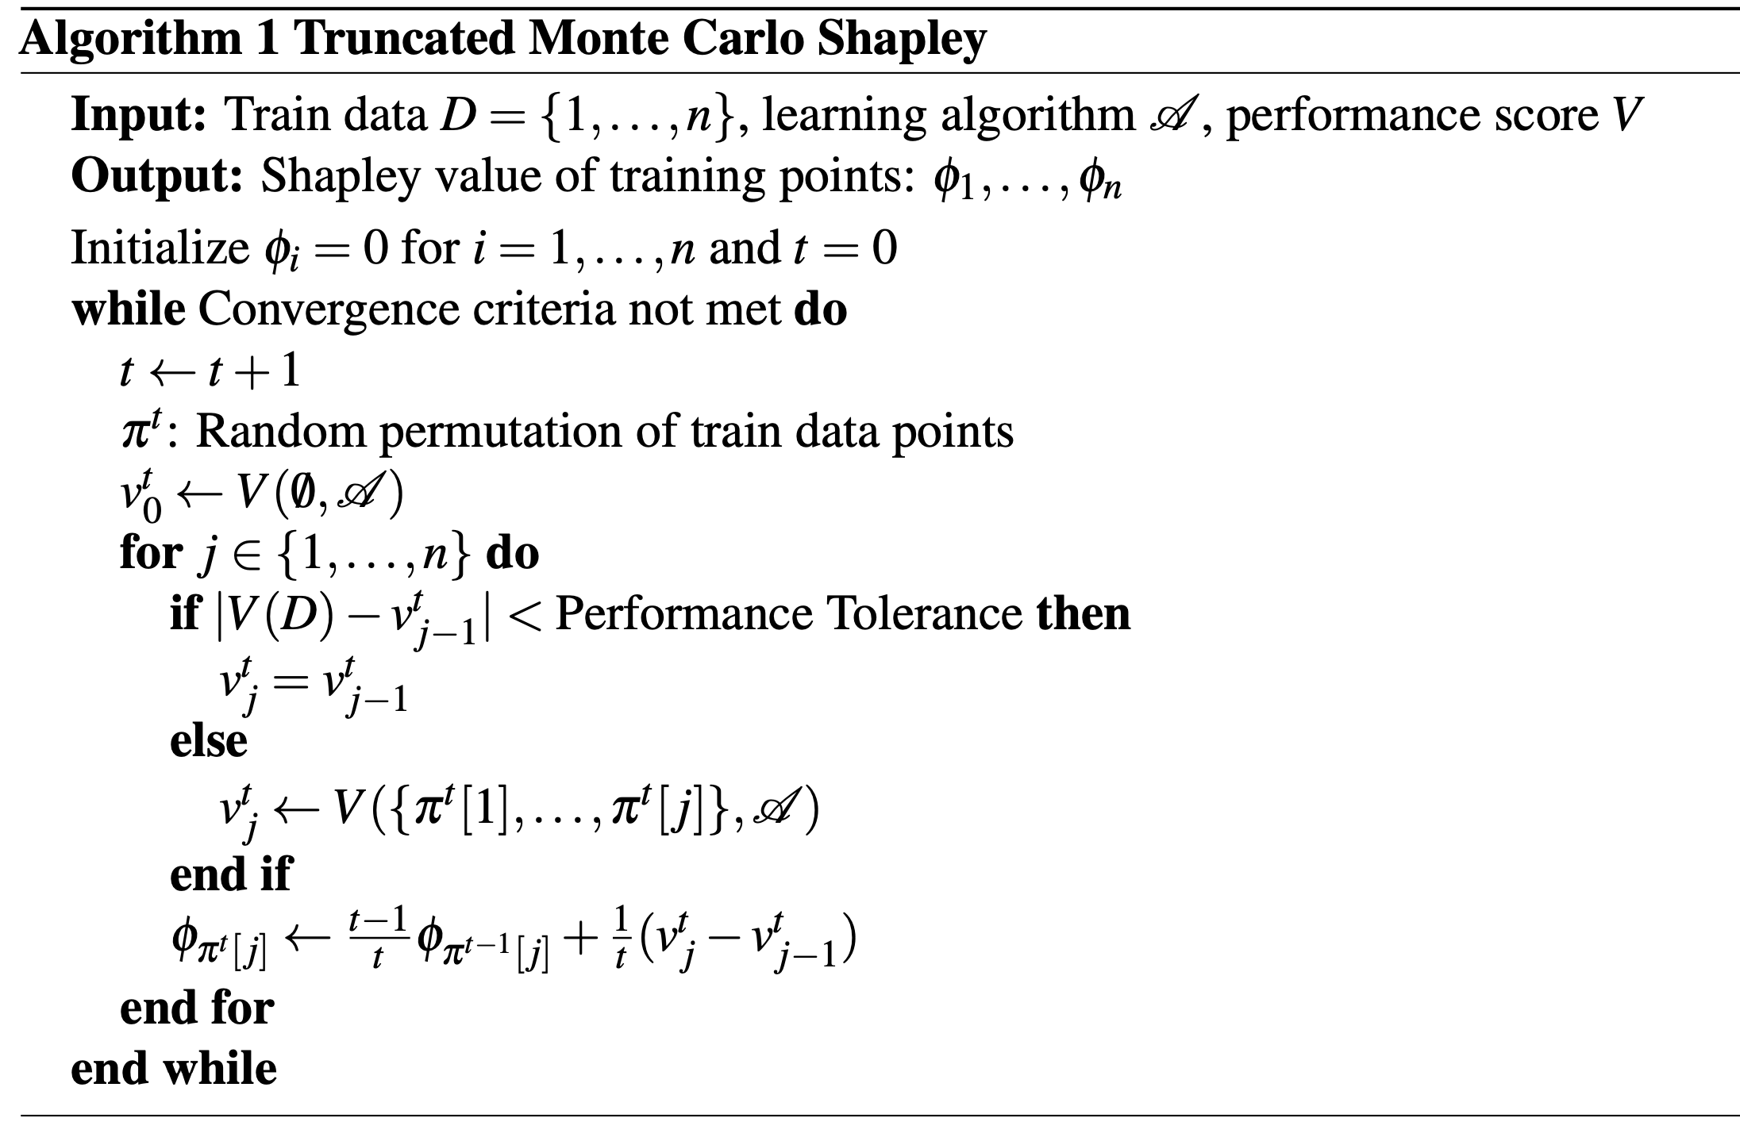
Proposed Solution - TMC
Notes:
Here is our proposed solution.

Slide 11
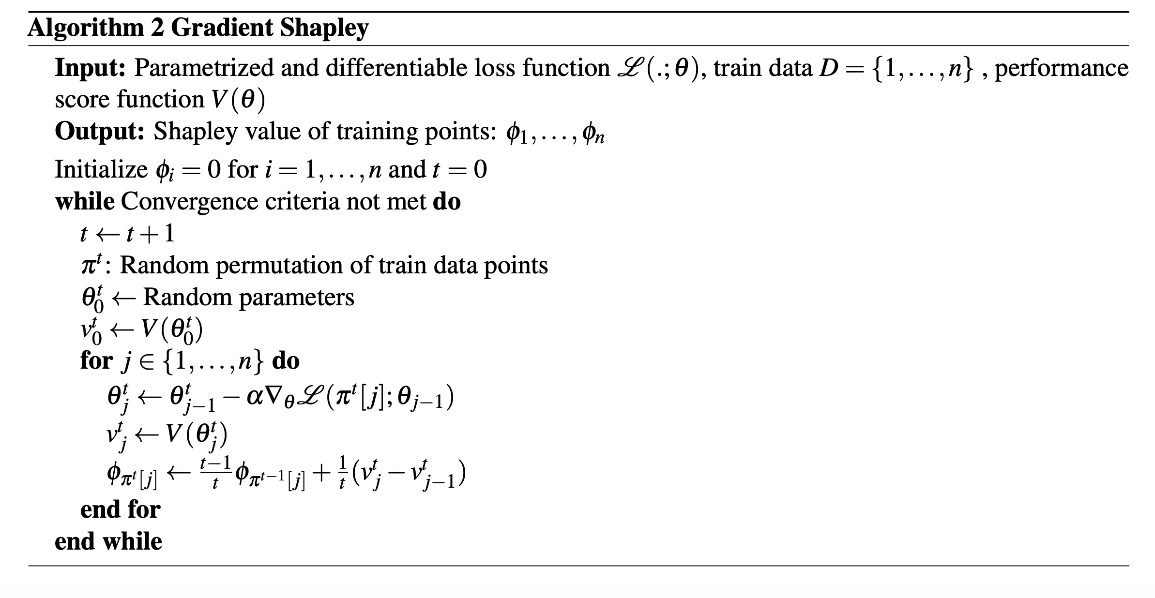
Proposed Solution - G Shapley

Slide 12
Experiments - Experiment 1a and 1b
Data Poisoning - Changing labels:
Changing labels of a few data points in a train set.
Then assigning data Shapley values to all the data points - considering the ones which have the lowest values.
The experiments proved that the mislabelled points have the lowest Data Shapley values.
This opens the potential for correcting this data and possibly improving quality of low quality data
Data Poisoning - Corrupting data:
Corrupting an image using noise.
Training the last layer of Inception v3 model
Again noisy images have least Shapley values
Notes:
In the rest of this presentation, I’m going to talk about following contents:

Slide 13
Experiments - Experiment 2 and 3
Adding data points of high Shapley values:
Training a Random forest classifier on the predicted Shapley values
Only adding high Shapley value based on the RF classifier in the training set from a new set
Removing Low value points:
Removing the points with lowest Shapley values
Domain Adaptation: Removing low value points and training on a new task
Notes:
In the rest of this presentation, I’m going to talk about following contents:

Slide 14
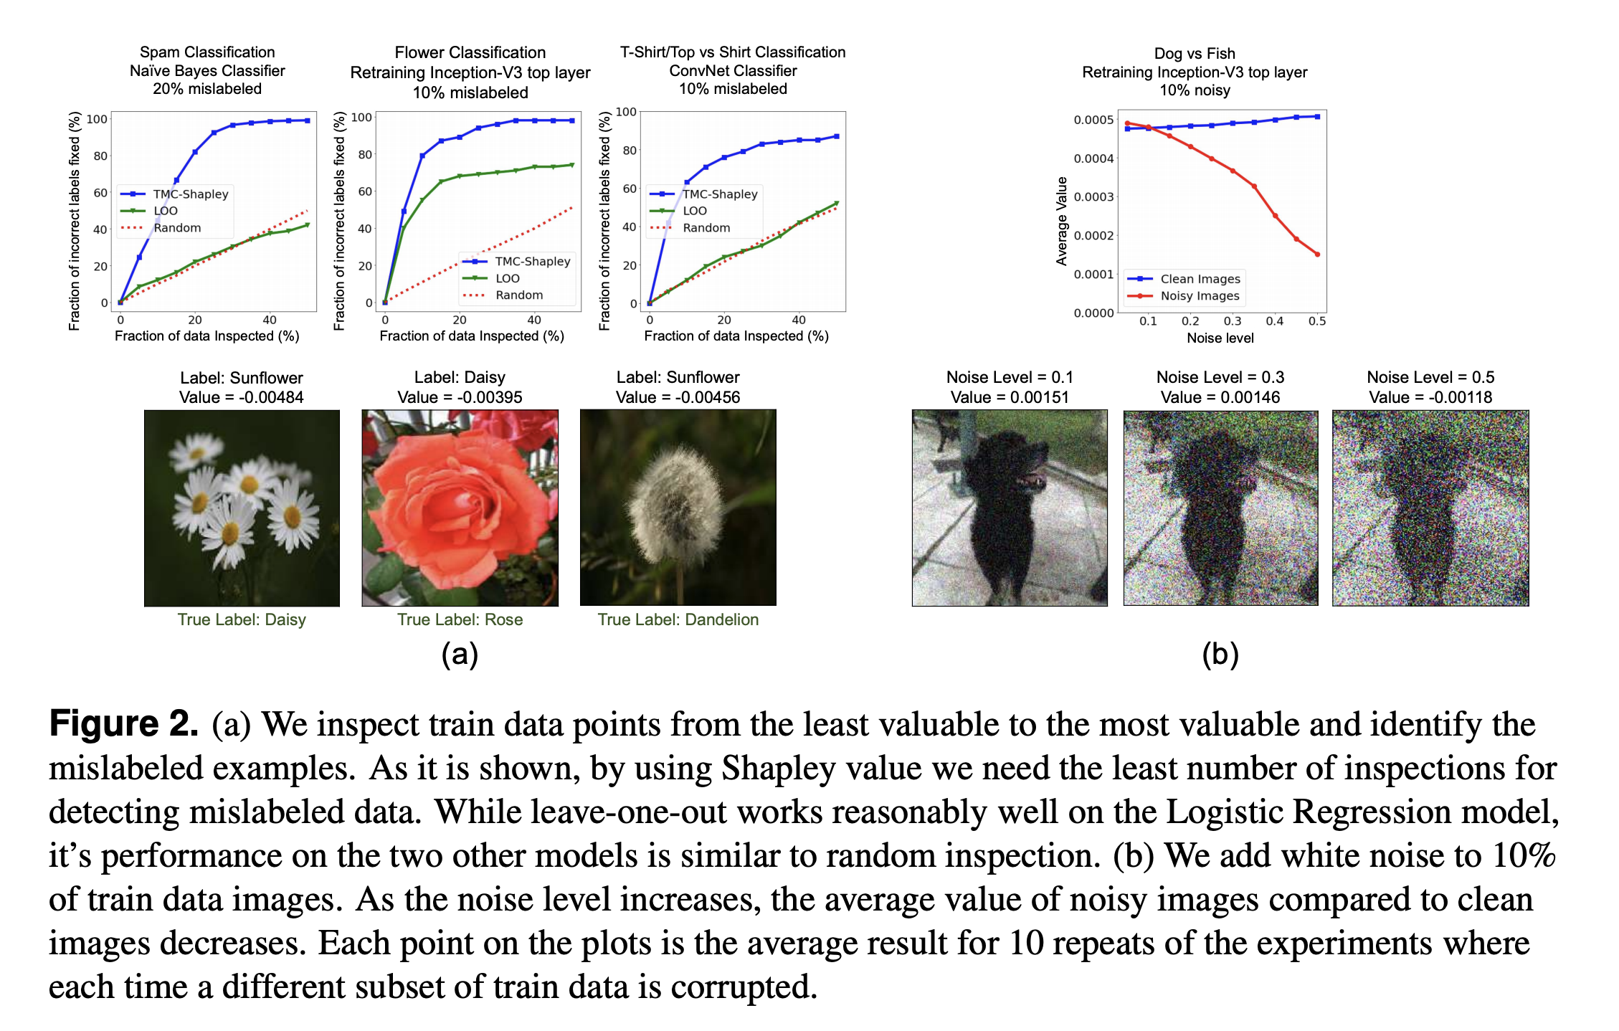
Experimental Analysis - 1a and 1b
Notes:
In the rest of this presentation, I’m going to talk about following contents:

Slide 15
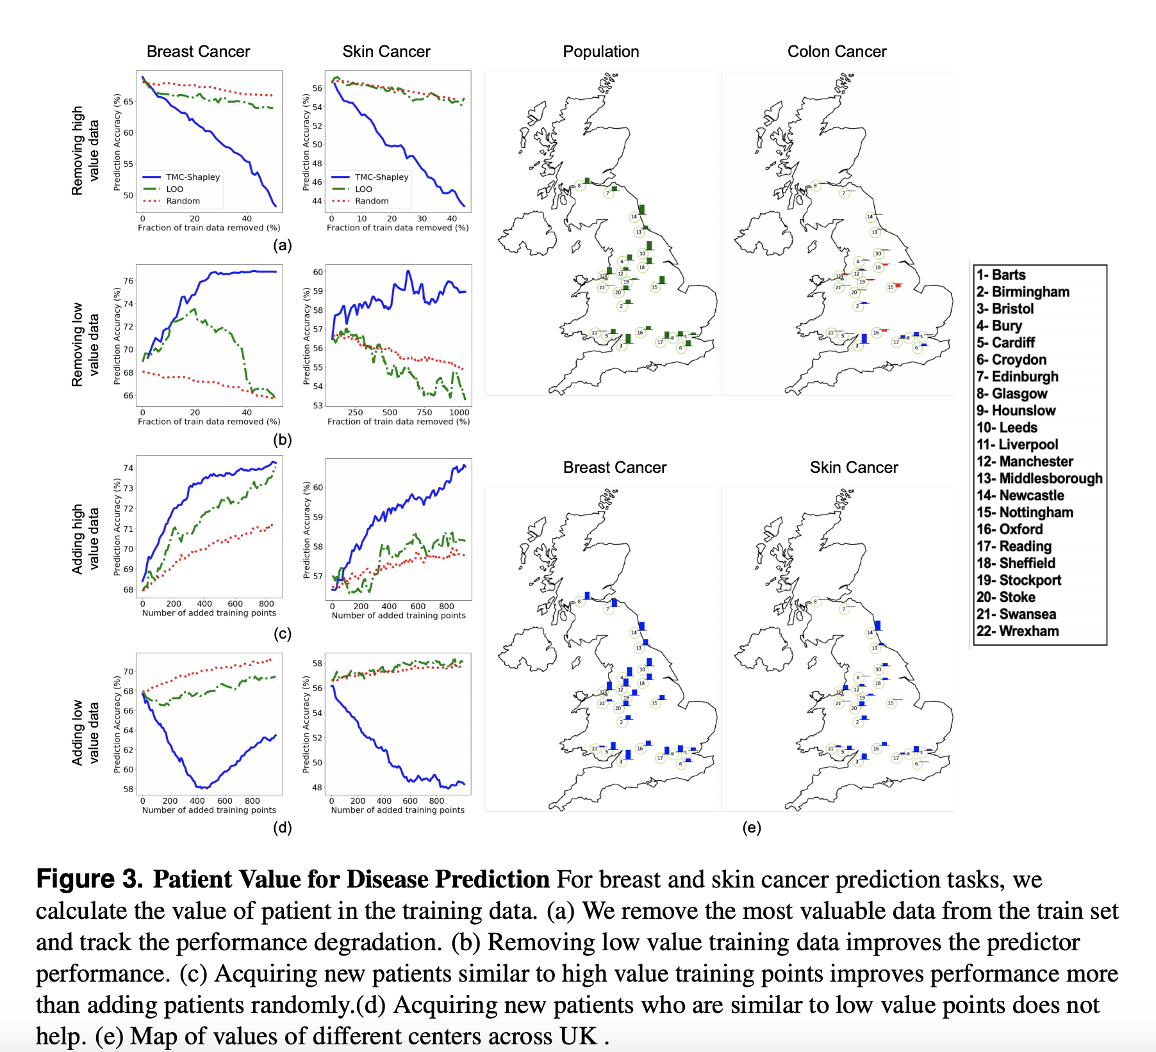
Experimental Analysis - 2
Notes:
In the rest of this presentation, I’m going to talk about following contents:

Slide 16
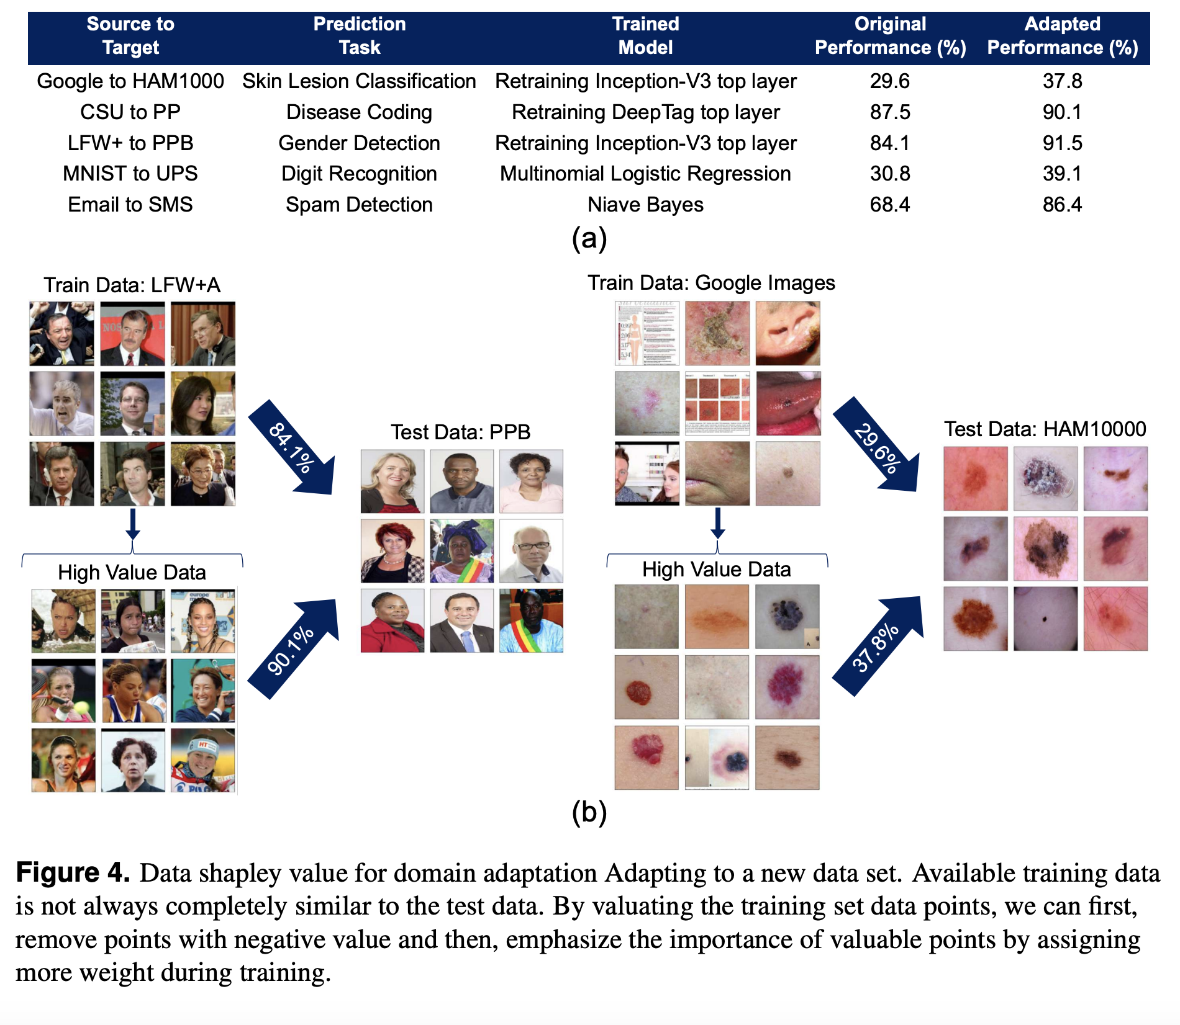
Experimental Analysis - 3
Notes:
In the rest of this presentation, I’m going to talk about following contents:

Slide 17
Conclusion and Future Work
Proposed a new technique for assigning values to data
Can be used for increasing performance by rooting out the low Shapley value points

